Slide 1
Containérisation Applications
Définition du scope de l’étude

Slide 2
Généralités
Docker
Solution de containérisation adoptée par tous les Majors IT
Cross-platform
Peu ou pas de concurrents (Roket, LXC)
Pourquoi les containers
Scalabilité Horizontale
Patch Management
Rapidité / Fiabilité de déploiement
Plate-forme d’exécution
Orchestration déploiement
Orchestration scalabilité
Services associés
Monitoring
Micro Service
Changement architecture applicative

Slide 3
Objectifs du document
Passer en revue les topics liés à la containérisation
Sélection des topics à inclure dans l’étude
Mettre une priorité :
Importante, moyenne, faible

Slide 4
Sommaire
Micro service
Docker
Application cibles
Application développement
Plateforme d’exécution
Architecture
Sécurité

Slide 5
Micro service
Pourquoi
Container souvent associé à Architecture micro services
Stratégie digitale = Services Métiers = Micro Services
Etude = Container ou plateforme micro service
Architecture cible = use case de validation
Les points à estimer
Architecture cible de nos futurs développements
Patterns pour les micro services
Intégration avec le Legacy
SLA
Back-end Strategy
Database Strategy
Security
Exposition Internet / Extranet
Donnée secrètes / confidentielles
Données localisées
Les problèmes
Développement déjà en cours
Pas de Solution Architect

Slide 6
Strategy
Pourquoi
Connaître la couverture à étudier / valider
Etude centrée docker ou plus globale PAAS
Les points à estimer
Les problèmes
Développement déjà en cours
Pas de Solution Architect

Slide 7
Intervenants externes
Pourquoi ?
Peu de connaissances sur le sujet
Des solutions en cours d’élaborations (version béta)
Besoin d’architectes
Les points à estimer
Création des scénarios de tests
Contact avec les sociétés externes
Redhat
Microsoft
Autres
Mise à disposition des environnements de POC / Validation
Les problèmes
Réalise t-on une véritable sélection : Appel d’offres
Interventions gratuites de ces sociétés

Slide 8
Environnement de développement
Pourquoi ?
Intégration des outils de développements dans la cible d’exécution
Modéliser l’interaction des services / regroupement des services avant déploiements (Composition de services, pods,…)
Pour tester la
Les points à estimer
Mise à disposition de Windows 10 ou VDI
Récupération / Installation des outils
Docker
Kubernetes (Minikubes)
OpenShift (MiniShift)
Service Fabric
Autres
Les problèmes
Nombre de téléchargements / sites bloqués
Pas d’images Windows 10 compliant
Nombre d’outils à tester
Droits Administrateur sur les PC
Outils instables : multiples réinstallations

Slide 9
Framework développement
Pourquoi
Apparition de nouveaux framework spécialisés pour les micro services
Développement .Net impactés
Nouveaux Framework = remise en cause de certains choix
Les points à estimer
Support .Net Core
Database supports
Messaging support
Security Support
Migration .Net standard vers .Net core
Les problèmes
.Net Core est récent v2.0

Slide 10
Annexes

Slide 11
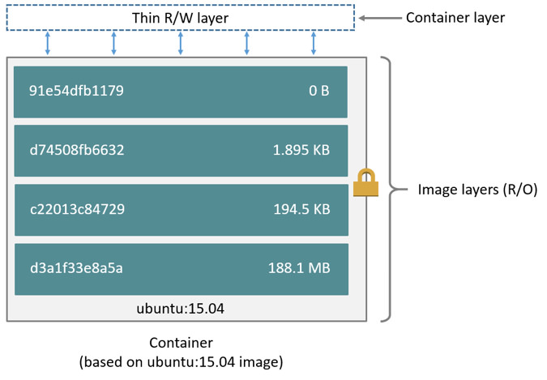
https://docs.docker.com/engine/userguide/storagedriver/imagesandcontainers/
A Docker image is built up from a series of layers. Each layer represents an instruction in the image’s Dockerfile. Each layer except the very last one is read-only. Consider the following Dockerfile:
FROM ubuntu:15.04
COPY . /app RUN
make /app
CMD python /app/app.py

Slide 12
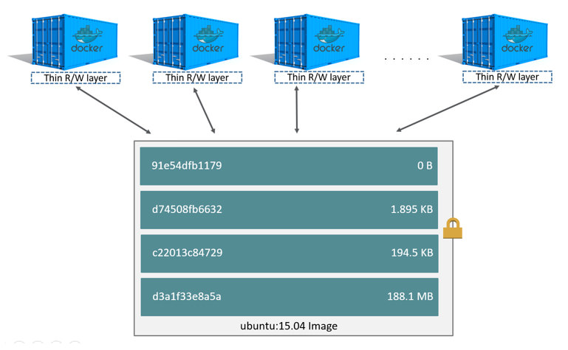
https://docs.docker.com/engine/userguide/storagedriver/imagesandcontainers/

Slide 13
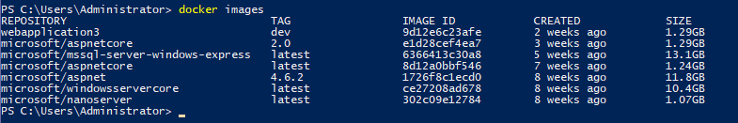

Windows Images
Linux Images

Slide 14
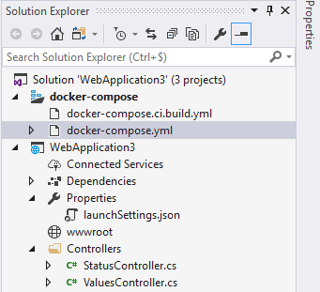
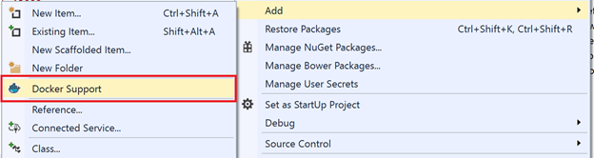
Integration development studio
Visual Studio
2017 : Integrated
2015 : Extension to be installed
Eclipse
Eclipse Neon 4.6.0

Slide 15
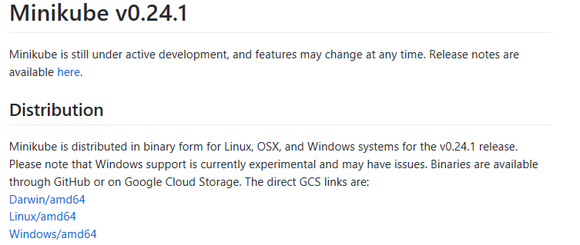
Kubernetes
Minikube
url : https://github.com/kubernetes/minikube/releases
Date : 14/12/2017

Slide 16
Micro Services - Redhat
Architecture
https://www.redhat.com/cms/managed-files/mi-microservices-eap-7-reference-architecture-201606-en.pdf
Definition : Page 4
Advantages / Disadvantages : Page 4-5
Cross-Cutting : Page 16

Slide 17
Micro Services - Microsoft
Architecture
https://www.microsoft.com/net/learn/architecture
NET-Microservices-Architecture-for-Containerized-NET-Applications-(Microsoft-eBook).pdf
https://www.microsoft.com/net/download/thank-you/microservices-architecture-ebook
Page 258 – Partial Failure Amplified in Micro Service
If you do not design and implement techniques to ensure fault tolerance, even small downtimes can be amplified. As an example, 50 dependencies each with 99.99% of availability would result in several hours of downtime each month because of this ripple effect. When a microservice dependency fails while handling a high volume of requests, that failure can quickly saturate all available request threads in each service and crash the whole application.
Page 41 – How to design communication across microservice boundaries
Therefore, in order to enforce microservice autonomy and have better resiliency, you should minimize the use of chains of request/response communication across microservices. It is recommended that you use only asynchronous interaction for inter-microservice communication, either by using asynchronous message- and event-based communication, or by using HTTP polling independently of the original HTTP request/response cycle.
Intégration avec outils Microsoft
Containerized-Docker-Application-Lifecycle-with-Microsoft-Platform-and-Tools-(eBook)_v1.1.pdf

Slide 18
Micro service – Architecture Pattern
Micro service Architecture
http://microservices.io/patterns/microservices.html
Database per service
http://microservices.io/patterns/data/database-per-service.html
Decompose by Business capability
http://microservices.io/patterns/decomposition/decompose-by-business-capability.html
Event sourcing
http://microservices.io/patterns/data/event-sourcing.html
Command Query Responsibility Segregation (CQRS)
url : http://microservices.io/patterns/data/cqrs.html

Slide 19
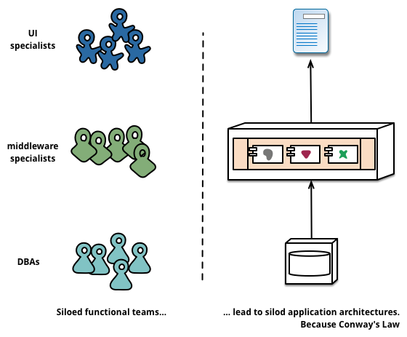
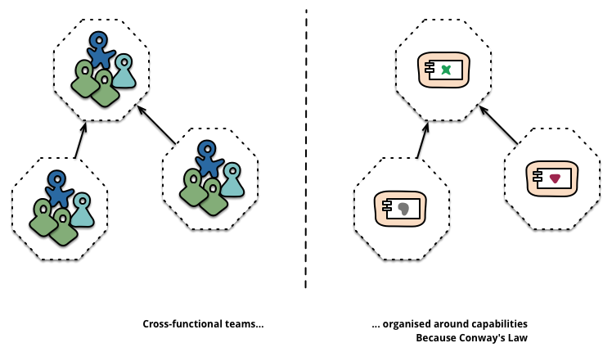
Micro service – Architecture Pattern
https://www.martinfowler.com/articles/microservices.html
Organized around Business Capabilities = Ready to Agile
When looking to split a large application into parts, often management focuses on the technology layer, leading to UI teams, server-side logic teams, and database teams. When teams are separated along these lines, even simple changes can lead to a cross-team project taking time and budgetary approval
Such services take a broad-stack implementation of software for that business area, including user-interface, persistant storage, and any external collaborations. Consequently the teams are cross-functional, including the full range of skills required for the development: user-experience, database, and project management.

Slide 20
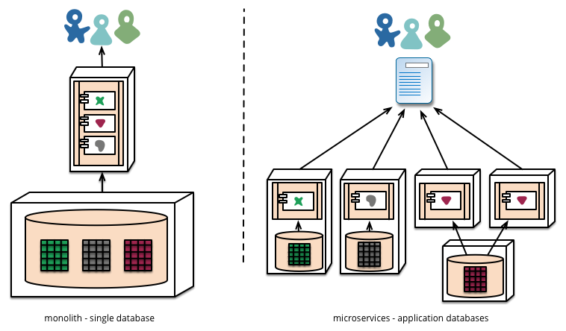
Micro service – Architecture Pattern
https://www.martinfowler.com/articles/microservices.html
Decentralized Data Management
A expliquer : Pas les mêmes besoins en terme d’entité (plu sou moins d’attributs, attributs spécifiques et communs) => DDD
While monolithic applications prefer a single logical database for persistant data, enterprises often prefer a single database across a range of applications - many of these decisions driven through vendor's commercial models around licensing. Microservices prefer letting each service manage its own database, either different instances of the same database technology, or entirely different database systems

Slide 21
Micro service – Architecture Pattern
https://www.martinfowler.com/articles/microservices.html
Decentralized Governance
“One of the consequences of centralised governance is the tendency to standardise on single technology platforms. Experience shows that this approach is constricting - not every problem is a nail and not every solution a hammer”
“Teams building microservices prefer a different approach to standards too. Rather than use a set of defined standards written down somewhere on paper they prefer the idea of producing useful tools that other developers can use to solve similar problems to the ones they are facing. These tools are usually harvested from implementations and shared with a wider group”

Slide 22
Enterprise image:
Windows 2016
Enterprise hub
Docker hub
microsoft/aspnet
microsoft/aspnetcore
microsoft/dotnet-framework
microsoft/dotnet
Linux RHEL
microsoft/windowsservercore
Windows 2016 nanoserver

Slide 23
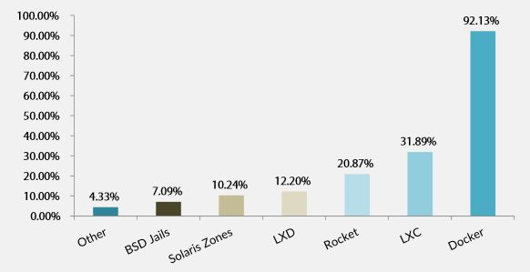
Docker : Standard
Docker is the standard
Resource : http://www.silicon.fr/conteneurs-plebiscites-docker-leader-inconteste-119810.html?inf_by=59fcd2a2681db87f588b4b04 22 juin 2015
Concurents
Resource : https://www.lemarson.com/thematic/1137/les-concurrents-de-docker-oui-ils-existent (2017)
LXC
Rocket By CoreOS
LXD
Solaris Zones
BSD Jails
Open Container Initiative

Slide 24
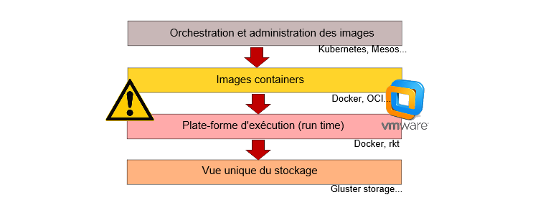
Docker :Concurrents
Model 4 couches Containers
Pourquoi Rocket
Resource : https://www.linformaticien.com/actualites/id/34959/coreos-lance-rocket-son-concurrent-de-docker.aspx (2014)
“Rocket doit se cantonner à un rôle de container, contrairement à Docker qui évolue vers une plateforme globale de services et de gestion. »

Slide 25
Docker : Uses cases
Table of Contents : https://www.gartner.com/doc/3574617/assessing-docker-containers-software-delivery
Analysis
Use Cases for Docker
Summary of Use-Case Assessments
Assessment Criteria
Use Case 1: Docker for Solo and Team Application Development and Test
Use Case 2: Docker for Continuous Integration
Use Case 3: Docker for Production Application Deployment
Use Case 4: Docker for Creating a Private PaaS
Use Case 5: Docker for Application Infrastructure and Cloud Portability
Strengths
Weaknesses
Guidance
Containers Are Not Suitable for Every Application
Use Docker in Production If You Have Sophisticated and Agile Operations
Consider Management, Monitoring, Backup, Disaster Recovery and Other Tools as Well as Orchestration
Plan on a Combination of Containers and Virtual Machines
Don't Build a PaaS Yourself Using Docker, but Build Docker Into Your PaaS Strategy
Gartner Recommended Reading

Slide 26
Docker : Monitoring
Docker is the standard
Concurents
Rocket By CoreOS
Monitoring containers
Resources : http://www.lemondeinformatique.fr/actualites/lire-6-outils-de-suivi-des-conteneurs-concurrents-a-docker-62190.html
cAdvisor by Google :
Open source : github
Simple
Suit uniquement les containers sur le même hôte
Promotheus.io by SoundCloud
Open source
Intégre données de nombreuses sources dont les conteneurs, cAdvisor, Kubernetes, Etcd, CoreOs
Scout
Service de monitoring
Plugin architecture
Price : 10 $ / host
DataDog
Service de monitoring
Reporting plus détaillé / flexible que Scout
Price : 15 $ / host
LogEntries
Service de monitoring
Sematext
Service ou on premise

Slide 27
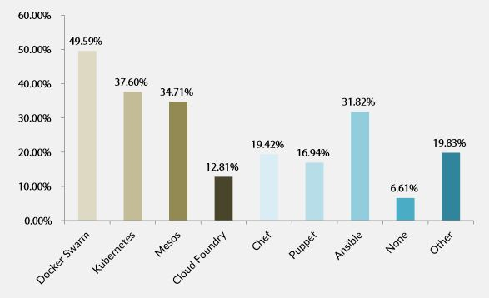
Platform Orchestrators / Services
Platform repartitions
Resource : http://www.silicon.fr/conteneurs-plebiscites-docker-leader-inconteste-119810.html?inf_by=59fcd2a2681db87f588b4b04 22 juin 2015
Resource : https://www.linformaticien.com/actualites/id/45342/docker-rend-les-armes-face-a-kubernetes.aspx (17/10/2017)
« Une étude d’avril dernier réalisée pour le compte de Sysdig, un éditeur de solutions de monitoring des environnements en containers, indiquait que parmi les entreprises ayant déployé des containers, 43 % avaient choisi Kubernetes, 9 % Mesos et 7 % Swarm »

Slide 28
Programmation Langages
.Net Framework
.Net Core
https://docs.microsoft.com/en-us/dotnet/standard/choosing-core-framework-server
Use .NET Core for your server application when:
You have cross-platform needs.
You are targeting microservices.
You are using Docker containers.
You need high-performance and scalable systems.
You need side-by-side .NET versions per application.
Use .NET Framework for your server application when:
Your app currently uses .NET Framework (recommendation is to extend instead of migrating).
Your app uses third-party .NET libraries or NuGet packages not available for .NET Core.
Your app uses .NET technologies that aren't available for .NET Core.
Your app uses a platform that doesn’t support .NET Core.
Java
Others

Slide 29
.Net Core
.Net Core Supported Interfaces
Oracle : http://www.oracle.com/technetwork/topics/dotnet/tech-info/odpnet-dotnet-core-sod-3628981.pdf : Only Managed drivers
https://blogs.msdn.microsoft.com/dotnet/2016/11/09/net-core-data-access/
.Net Core Not Supported Interfaces
IBM MQ : check version 9.0.x
Tips :
https://docs.microsoft.com/fr-fr/aspnet/core/mvc/models/validation
https://docs.microsoft.com/en-us/aspnet/core/security/authentication/windowsauth?tabs=aspnetcore2x

Slide 30


.Net Core : web servers
ASP.NET Core ships two server implementations
Kestrel is a cross-platform HTTP server based on libuv, a cross-platform asynchronous I/O library.
Kestrel supports the following features:
HTTPS
Opaque upgrade used to enable WebSockets
Unix sockets for high performance behind Nginx
Kestrel is supported on all platforms and versions that .NET Core supports.

Slide 31

.Net Core : web servers
ASP.NET Core ships two server implementations
HTTP.sys is a Windows-only HTTP server based on the Http.Sys kernel driver.
Http.Sys is mature technology that protects against many kinds of attacks and provides the robustness, security, and scalability of a full-featured web server. IIS itself runs as an HTTP listener on top of Http.Sys.
HTTP.sys is a good choice for internal deployments when you need a feature not available in Kestrel, such as Windows authentication.
HTTP.sys supports the following features:+
Windows Authentication
Port sharing
HTTPS with SNI
HTTP/2 over TLS (Windows 10)
Direct file transmission
Response caching
WebSockets (Windows 8)

Slide 32
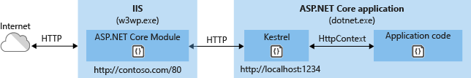
.Net Core : web servers
ASP.Net Core Module
ANCM has a few other functions as well:
Sets environment variables.
Logs stdout output to file storage.
Forwards Windows authentication tokens.
ANCM does not support HTTPS forwarding, so requests are forwarded over HTTP even if received by IIS over HTTPS

Slide 33
Resources
Gartner :
https://www.gartner.com/doc/3574617/assessing-docker-containers-software-delivery
https://www.gartner.com/doc/3512817/need-know-docker-containers

